Slide 1
IBM Marketing & Experience Transformation
Unlocking the Value of Generative AI for Search
…with precision, impact and trust
Starting with a GEO Assessment
Marketing Transformation / IBM Consulting / © 2025 IBM Corporation

Slide 2
Why your digital presence needs an urgent update
The digital landscape is fundamentally changing. Search engines are rapidly transforming into "answer engines," providing direct summaries that often make clicking on links unnecessary.
.
62%
58%
30-60%
AI Consumer Use
Growth in global use of applications such as ChatGPT and Gemini, with 82% for GenX and 92% for Boomers.*
Zero-Click Searches
The majority of Google searches now end without a click to an external website, as users find answers directly on the results page.**
Drop in Organic CTR
When AI Overviews appear, organic click-through rates can decrease by an average of 30%, with some publishers seeing drops up to 60%.***
Answer Engine Optimization (AEO)
Generative Engine Optimization (GEO)
Generative Experience Optimization (GXO)
Optimizing direct answers in featured snippets, knowledge panels, and AI Overviews.
The practice of shaping digital content so generative AI systems can understand, trust, and surface your organization’s expertise in AI generated responses.
Incorporating both brand answers, along with authority beyond your site in third party sources to increase visibility and authority.
*Source: IBM IBV retail study , released March 2026/
**Source: Adapting Social. (2025, March 26). How AI-Generated Answers Are Changing Search & SEO Strategy - Adapting Social. /
***Source: Search Engine Land. (2025, April 21). New data: Google AI Overviews are hurting click-through rates.

Slide 3
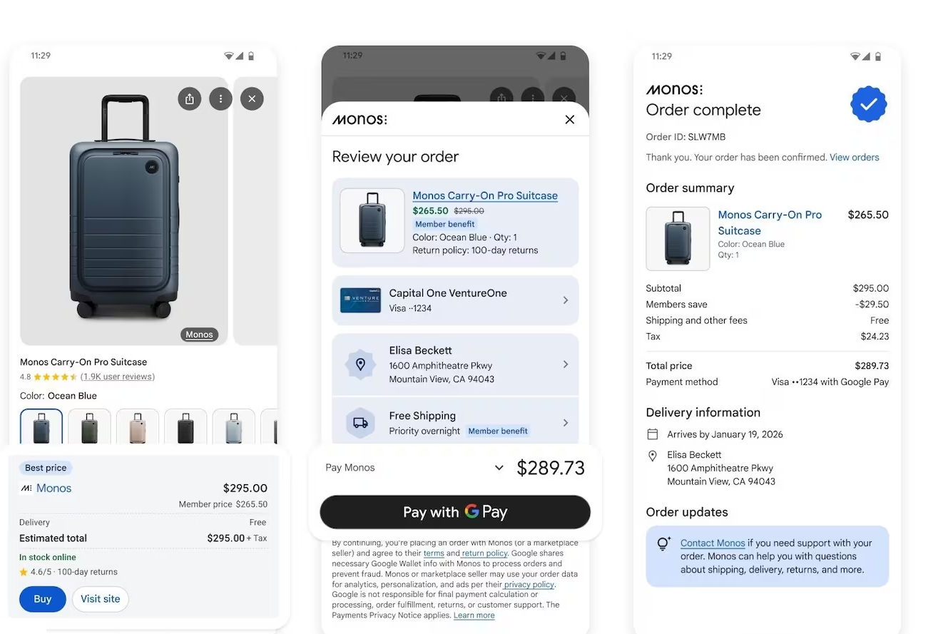
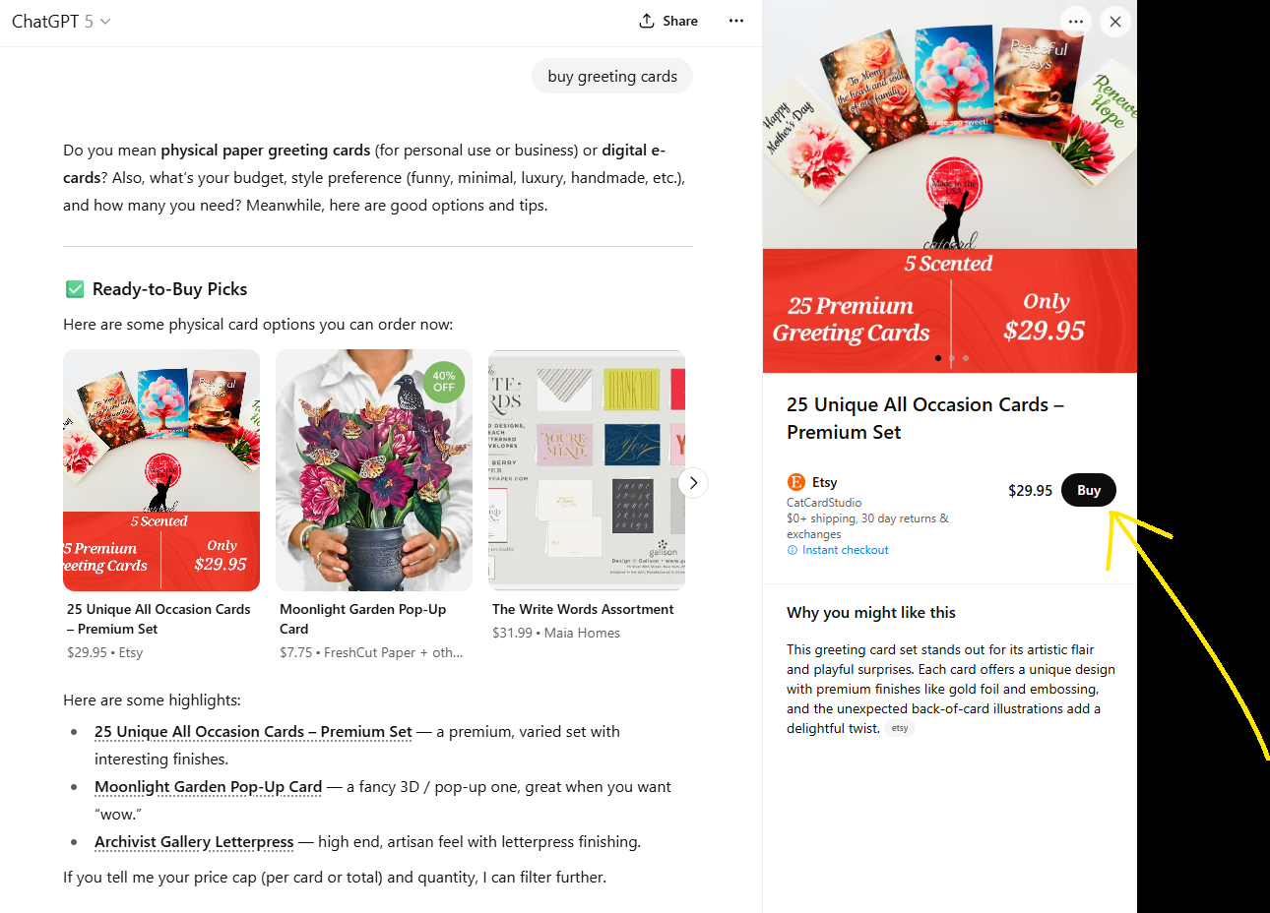
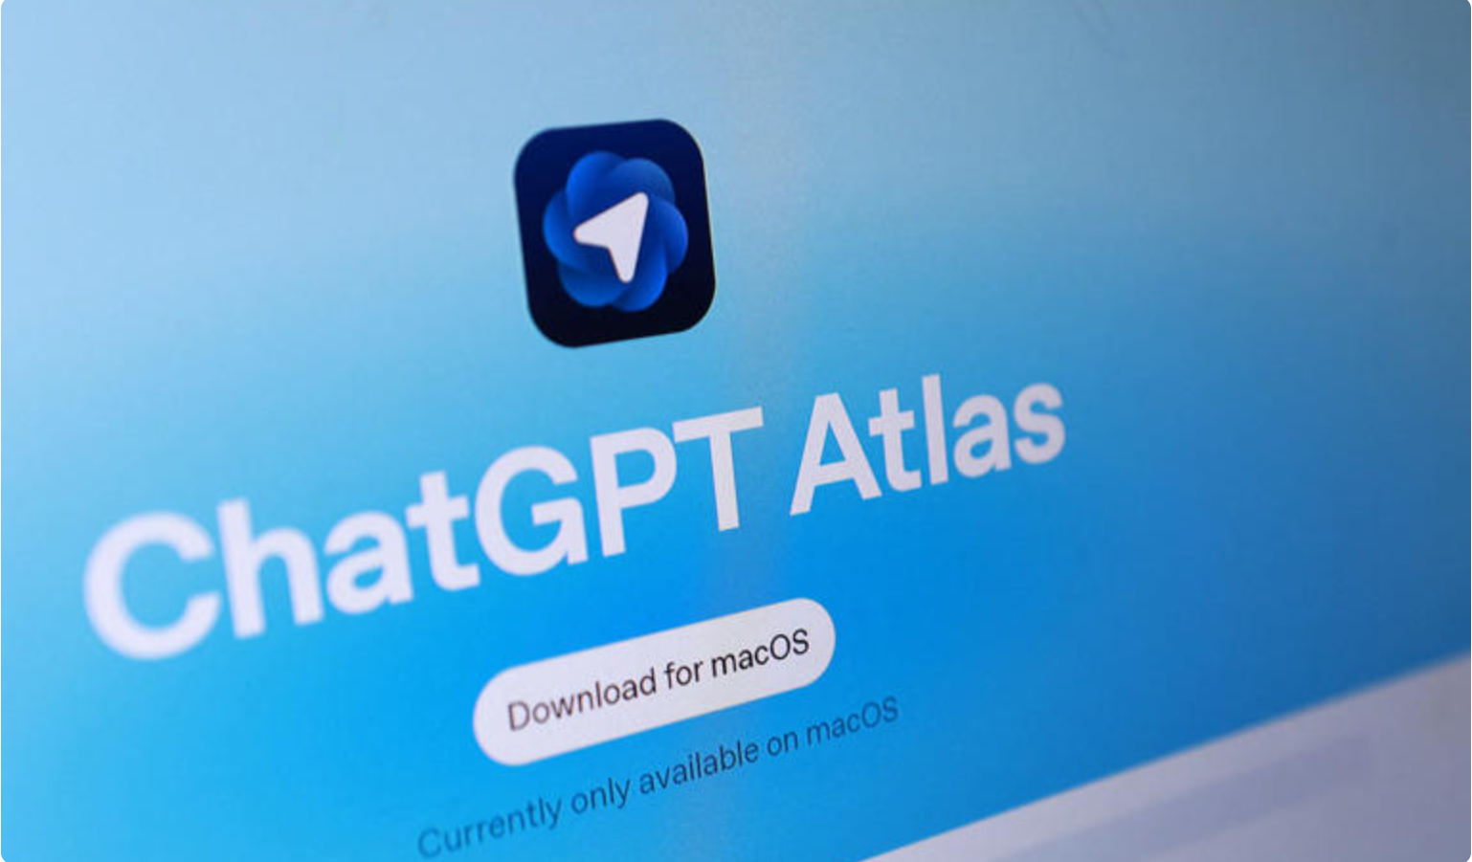
The New Search Reality: An AI-powered customer experience
Through Instant Checkout, ChatGPT now let’s you make purchases without ever leaving the chat
ChatGPT Atlas blends internet navigation with the capabilities of agentic AI. This browser can take actions such as making appointments and filling grocery carts on behalf of the user
Google’s Gemini AI Mode will call stores near you to confirm inventory, prices and promotions and update you directly.
Their Universal Commerce Protocol (UCP) now allows you to purchase products within. seamless sales journeys between consumer interfaces, enterprises, and payment providers.
.

Slide 4
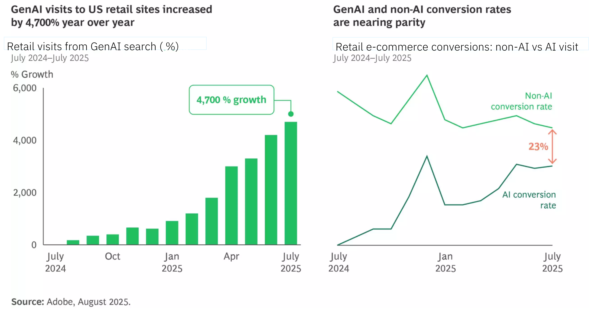
Brand Visibility today and tomorrow: Chatbot reach and acceptance are growing fast
1200%
Increase in traffic from generative AI sources to U.S. retail websites between mid-2024 and early 2025³
71%
of consumers want to use generative AI in their shopping experiences⁴
87%
of consumers state they are more likely to use AI for larger and more complex purchases³
Sources: 1 OneLittleWeb (2025), 2 Gartner (2024), 3 Adobe Blog (2024), 4 Capgemini (2025)
IBM iX / © IBM Corporation

Slide 5
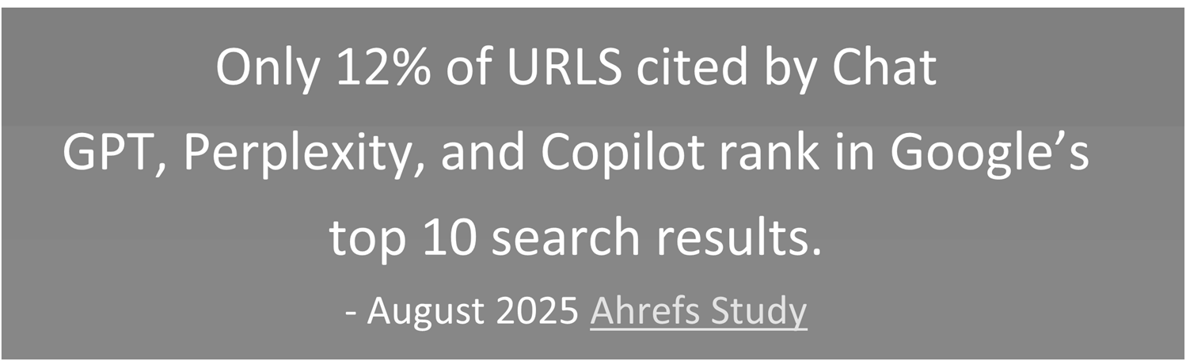
Marketing to Machines
Search enginges operate differently than consumers
62%
Of the time ChatGPT, Google AI Mode and Google AI Overviews give different brand recommendations and only
Agents behave differently from humans: they prioritize price, user ratings, delivery speed, and real-time inventory over brand familiarity or loyalty. This has the potential to reshape how brands compete.
Agents prioritize insights drawn from social and community platforms like Reddit, Wikipedia, and YouTube, which means brands must build and maintain a wider presence
“If your brand isn’t creating video content, you may be invisible in AI search. YouTube isn’t just winning – it’s the video platform that AI platforms appear to trust”
17%
of the time they all agree
Non-paid media continues to dominate AI citation behavior. About 94% of all citations come from non-paid sources, and earned media alone accounts for 82%. Journalism remains a major influence, accounting for about 20-30% of citations over any period.
Earned Media Still Drives Generative AI Citations as Press Release Visibility Grows
Confidential IBM Consulting 2025

Slide 6


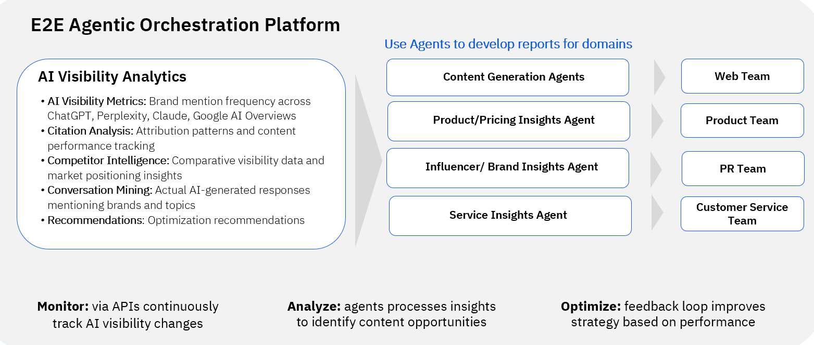
Preparing for the new world of AI Search
Website Content Must Change
Content Structure
HTLM Signals
Reasoning Clues
Schema Markup
Topics not Keywords
Content Formats
Self-contained Chunks
.
Website Technology Must be Updated
LLM Crawlability
Multi-Modal Optimization
Server-Side Rendering
Submission protocols
Canonicalized and indexable sources
Speed of page load
… and implement GEO at scale through agentic orchestration
Confidential IBM Consulting 2025

Slide 7
Winning with AI Search starts with in depth understanding
Confidential IBM Consulting 2025
Confidential IBM Consulting 2025

Slide 8
Brands need to respond to the changing landscape now.
The first step is gaining insights!
Learn how the brand shows up with Generative Search engines
Are you in the general conversation?
Which specific conversations are you in?
How do different AI Search platforms talk about you?
What is your brand’s sentiment?
Which domains/publications are influencing the conversation within AI Search in your industry?
Confidential IBM Consulting 2025

Slide 9
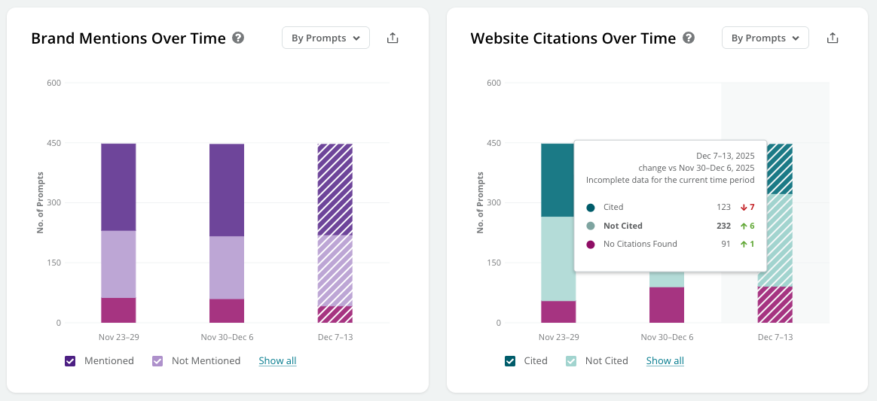
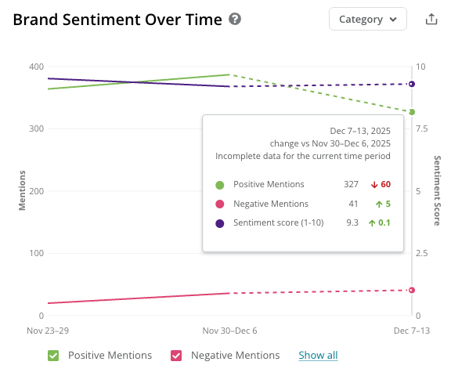
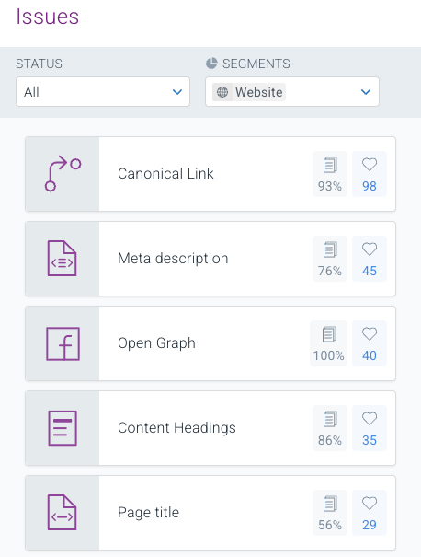
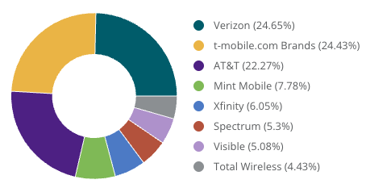
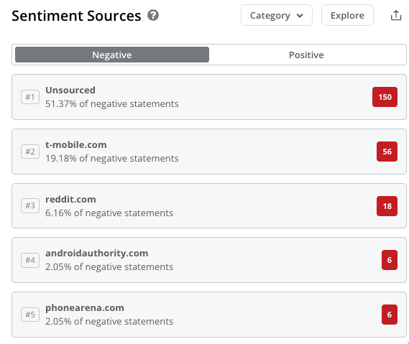
Turning Search Insights to Actions
AI Mentions & Citations
Sentiment Analysis
Technical Health
Understand your brand through the lens of AI engines.
Analyze and influence sources of negative sentiment.
Establish a strong technical website foundation for discoverability.
Confidential IBM Consulting 2025

Slide 10
AI Search Assessment, POC and Roll
Turning insights into action to win in AI Search
Marketing Transformation / IBM Consulting / © 2025 IBM Corporation

Slide 11
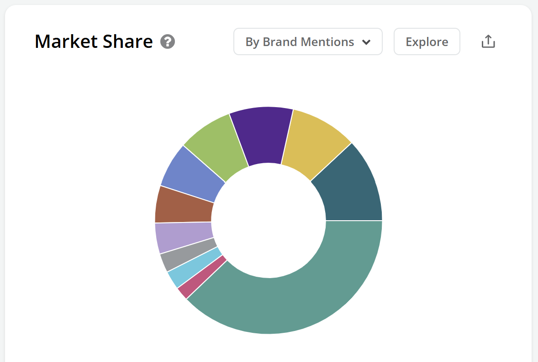
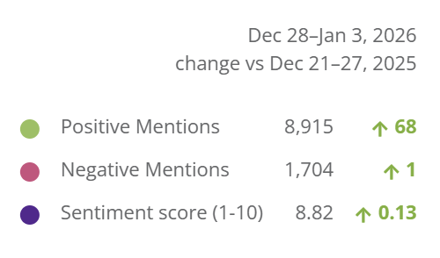
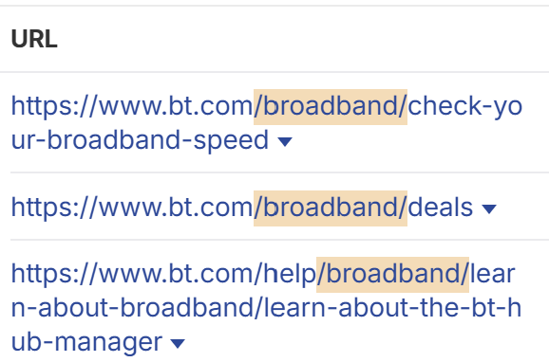
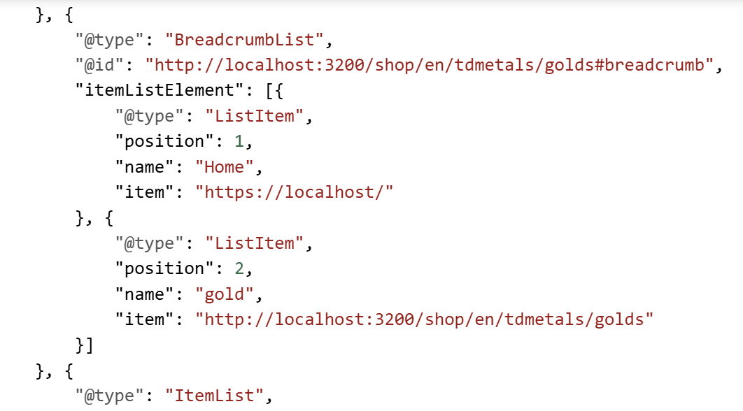
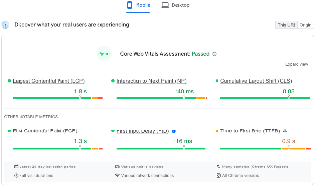
Our AI Search Assessment
Five-Pillar Analysis to Secure Your Market Position
1
Visibility in AI-Answers & Market Position
2
Sentiment
& Reputation Management
3
Content Analysis
4
Data Analysis
5
Technical AI Optimization of Digital Assets
  How often you appear
  in AI responses
  Mentions and Citations
  Competitors and influencers
  Dynamics of Agents
  How AI systems
  describe you
  Information accuracy
  Whether strengths are cited
  How your content stacks up to the leaders
  Which content AI prefers and why
  How your content is positioned
  How your site supports
  AI visibility
  Structured data quality
  Schemas etc.
  Infrastructure
  readiness
  Rendering
  Crawlability and extactability
Deliverable: AI Readiness Evaluation + Action Plan
Confidential IBM Consulting 2025

Slide 12
AI Search Assessment Scope and Methods
Strengthening brand entity and harvesting insights to improve brand delivery
AI Search Assessment
Establish Current and Future State
Recommendations and Roadmap
Analyze current AI Optimization profile and competitors for a defined industry or product category.
Surface visible patterns that will impact brand presence on AI side
Owned and 3rd party sites
Types of content
High priority topics and prompts
Understand Client’s technical configuration and ease of indexing by LLMs.
Recommend optimization strategy for improving brand visibility in AI results
Requirements:
Whitelisting of technical crawler (if required)
Client resources: Content team, Digital Marketing/SEO, DevOps
Activities
Identification
Define focus product/service
Strategic Intent
Alignment on desired future state and define metrics for success – 2-3 hour working session
Investigation
SME interviews to understand technology – onsite 1 day discovery and 2-3, 1 hour sessions as follow-up.
Request access to current SEO results
Evaluation of current site AI and technical performance- requires minimum 1 week of data tracking
Activities
Results Readout
AI search visibility report review
Opportunity Identification
Presentation of recommendations for improved AI Search
Roadmap
Team prioritization of recommendations based on defined success criteria and degree of effort
POC
IBM to present proposal for execution of POC(s)
Confidential IBM Consulting 2025

Slide 13
Website transformation to respond to AI Search
Strengthening brand entity and harvesting insights to improve brand delivery
GEO Assessment
Pilot recommendations
Operationalize and Scale
Finalize the business case for change
Secure required licenses and resources * see next page
Implement new processes for content and code
Prioritize and phase roll-out to full brand site
Timing: Phased based on internal team capabilities and business priorities
Analyze current AI Optimization profile and competitors generally for a defined product suite.
Surface visible patterns that will impact brand presence on AI side
Owned and 3rd party sites
Types of content
High priority topics and prompts
Understand Client’s technical configuration and ease of indexing by LLMs * see technical check list
Recommend optimization strategy for improving brand visibility in AI results
Select priority actions from the GEO Assessment recommendations to implement through a rapid POC process.
Apply required insight, and action tools to make modifications
Technical enhancements
Content modification
Product/service experience updates.
Track and Measure results for 4 weeks and report on outcomes to build the business case for change.
Technical Site Updates
One time review and rework to optimize
Establish refresh process leveraging AI automation
Implement tracking
1
AI-enabled Content Development and Deployment
Implement Agents to condition copy and tag images to optimize; apply guardrails for legal/brand standards
Implement with automation and appropriate supervision
Develop content aligned to key citation influencers
Expand testing to align to search insights
2
Insights Mining and Reporting
Harvest insights from prompts, citations and visibility tracking
Apply agents to summarize and provide reporting for stakeholders aligned to their specific domain needs ( product, PR, customer service)
Refresh prompt evaluation on a frequent basis
3
Confidential IBM Consulting 2025

Slide 14
NA Bank
IBM’s AI Search Assessment, Recommendations and Run
Transforming site experience through code, content and context to win in the new world of AI Search
SEO Audit of a selected Brand
Website Implementation
GEO assessment and actions underway
Recommended Actions
Site taxonomy enhancements
Technical SEO enhancements
Updated customer features
Content updates by persona
Outcomes
Traffic increased from 500k to 1.6M
New customer features delivered 650% segment growth.
Achieved 41% AI visibility score (2nd in category)
Grew high-intent transactional segment by 45%
Incorporating GEO impacts
Implemented a GEO evaluation with resulting use case prioritization
Optimizing content for LLM consumption
Establishing AI-Ready FAQ Hub
Expanding customer features proven in first phase
Adding educational content for key influencers

Slide 15
US Insurance Company
IBM’s AI Search Assessment and Estimated Impact
Sample Assessment Findings
Brand mentions
When the prompt aligns with the brand’s core strength mentions are strong but when intent shifts to broad categories mentions diminish
Brand citations
Publishers and aggregators lead in citation rankings along with the two key market competitors.
FAQ and local pages driving citation presence.
Content Evaluation
Lack of depth of FAQ pages
Lack of city-level child pages
Lack of content consistency
Pillar page weakness
Technical Evaluation
Poor schema markup present
Data structure impacting readability
Sample Recommendations and Value Estimation
Recommendations
Full review of site Architecture
Establish visibility and GEO content platform
Address content and technical issues identified
Implement ongoing tracking for new KPIs
Projected Uplift for one product line (Directional)
Increase in share of mentions 12 points from 44%-56%
Move market share of citations from .35% to 3% (10X)
Combined 12 month projection = $1.3M in additional revenue/year

